Slide 1

XML Rule Engine
Ing. Pablo Pazos Gutiérrez
pablo@openehr.org.es

Slide 2
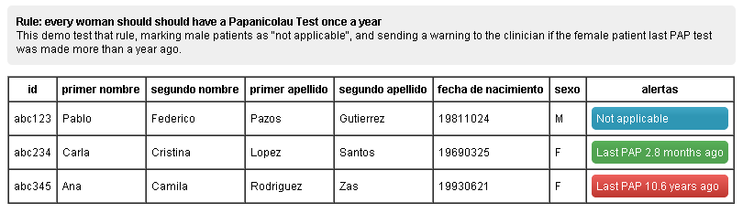
XRE Requirements
Requirement:
  Women should have a PAP test once a year.
Rule:
  If last PAP test of a patient was done more than a year ago, then send an alert

Slide 3
XRE Features
Simple & Effective:
  Complexity is hidden from the user
Scalable & Extendible:
  New rules, new actions, new variable resolutions
Consistency & Reuse:
  Many systems using the same rules, the same way
Distributed:
  Access data from many systems via HTTP
REST API:
  JSON & XML output
Complete lifecycle logs:
  Something wrong? Each step & state change is logged

Slide 4
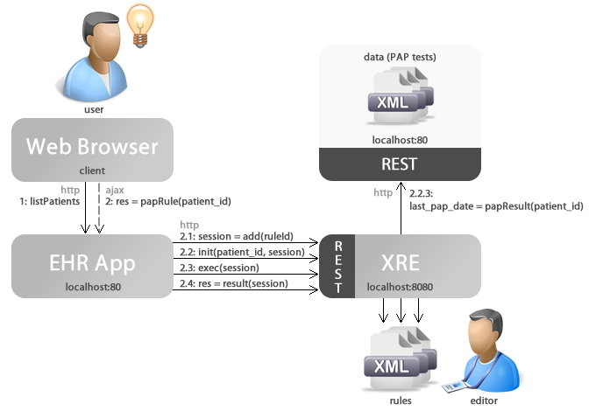
XRE Interactions & Architecture

Slide 5
XRE Interactions
session = add(ruleId)
  clone rule & add to executer
  state = ADDED
  synchronous (send & wait)
init(params, session)
  params = [patient_id: abc234]
    input params are used for http resolution
  variable resolution (http, action, constant)
  state = INITIALIZED
  asynchronous (send & forget)

Slide 6
XRE Interactions
exec(params, session)
  receive input values
  evaluate rule logic
  state = STARTED ➔ FINISHED
  asynchronous (send & forget)
res = result(session)
  get execution result
  state = ARCHIVED
  synchronous (send & wait)

Slide 7
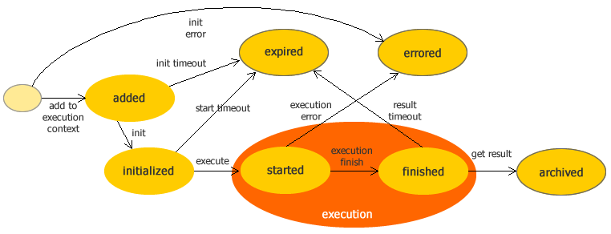
XRE States
Rules are defined and loaded into the engine
Then can be added to the execution context

Slide 8
XRE Rule logic
<if>
<gt in1="days_from_last_pap" inc2="365" />
<do>
<action type="print" in1="last_pap_test_date"></action>
<action type="print" in1="days_from_last_pap"></action>
<action type="assign" var="code" value="ret_warning" />
<return name="last_pap_test_date" />
<return name="days_from_last_pap" />
<return name="code" />
</do>
</if>
<else>
<do>
<action type="assign" var="code" value="ret_ok" />
<return name="last_pap_test_date" />
<return name="days_from_last_pap" />
<return name="code" />
</do>
</else>

Slide 9
XRE TODOs
More actions
  Calculations over values (-, *, /, …)
  Collection mgt. (lists, sets)
  Transformation operations (toLowerCase, …)
More rules
  Complete test cases with real life rules
  Suggestions are welcome!
SOAP API
Rule Editor (WYSIWYG)
Standalone WAR/JAR
  For easy deployment and integration

Slide 10

XML Rule Engine
Ing. Pablo Pazos Gutiérrez
pablo@openehr.org.es

